Slide 1
Linear Transformation -PCA CSCI-347 Data Mining
Adiesha Liyana Ralalage

Slide 2
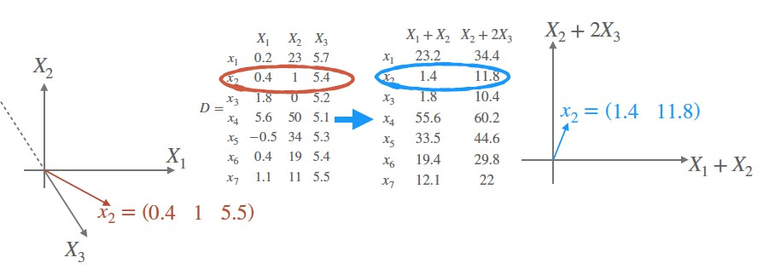
How can we find the best low-dimensional representation of the data?
Dimensionality reduction can be accomplished by:
Selecting a subset of attributes of the dataset.
What are the possible advantages and disadvantages?
Using all the attributes to create new attributes that can represent the data

Slide 3
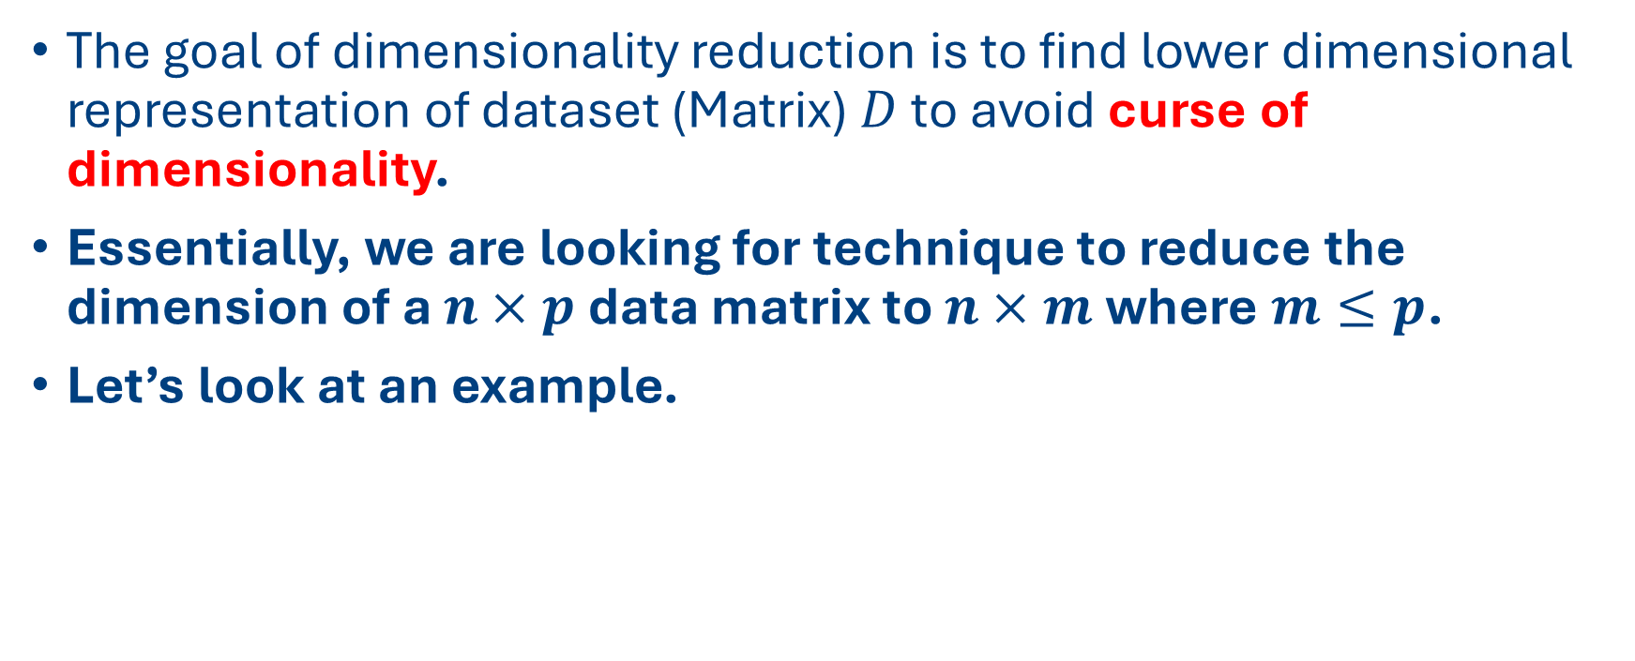
Dimension Reduction
The goal of dimensionality reduction is to find lower dimensional representation of dataset (Matrix) $D$ to avoid curse of dimensionality.
Essentially, we are looking for technique to reduce the dimension of a $n×p$ data matrix to $n×m$ where $m≤p$.
Let’s look at an example.

Slide 4
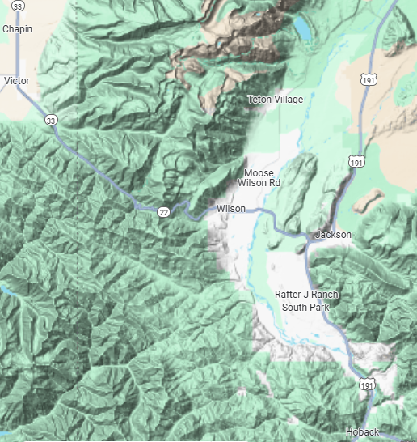

Dimension Reduction
The idea is to replace large number of variables in the data with a smaller number while maintaining a good representation of the data.

Slide 5
Principal Component Analysis (PCA)
Principal Component Analysis (PCA) is the most common dimension reduction technique.

Slide 6


Principal Component Analysis (PCA)
Let’s try to draw a simple diagram of a bicycle in 2D plane.

Slide 7


Principal Component Analysis (PCA)
Most of you would draw something like this.

Slide 8
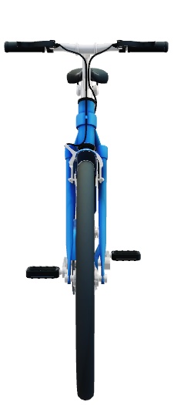
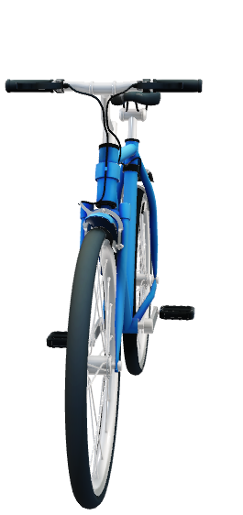
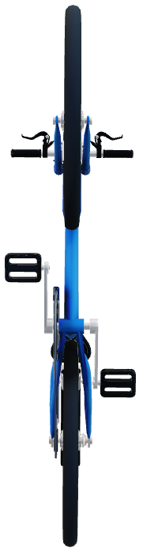
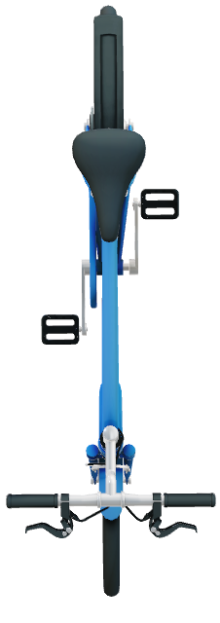
Principal Component Analysis (PCA)
But you wouldn’t look at the bicycle in the following angles to draw.

Slide 9

Principal Component Analysis (PCA)
When you draw a diagram of a bicycle , we are projecting a 3D object onto a 2D plane. Most people would draw the diagram of the bicycle along its most elongated axes. Such projection captures lot more information about the bicycle than other angles.
y
x

Slide 10
Principal Component Analysis (PCA)
When you draw a diagram of a bicycle , we are projecting a 3D object onto a 2D plane. Most people would draw the diagram of the bicycle along its most elongated axes. Such projection captures lot more information about the bicycle than other angles.
y
x

Slide 11
Principal Component Analysis (PCA)
The same idea is used in PCA.
PCA is mathematical technique that allows you to find a desirable projection that reduces the number of features (attributes) in a matrix while preserving as much information as possible.
The way PCA achieves this goal is by finding the directions in feature space along which the data has the largest spread or variability.

Slide 12
Principal Component Analysis (PCA)
PCA produces a low-dimensional representation of a dataset.
PCA finds a sequence of linear combinations of the variables that have maximal variance and are mutually uncorrelated.
What can we do with PCA?
Produce derived variables for use in supervised learning problems (Feature selection)
Serves as a tool for data visualization.

Slide 13
Principal Component Analysis
The first principal component direction of the data is the direction which the observations vary the most or the direction with the largest variance.
The second principal component maximize variance in the subspace orthogonal to the first principal component.
Thus, we basically replace original variables (features/attributes) that may have been correlated with a small set of principal components that capture their joint variation.

Slide 14
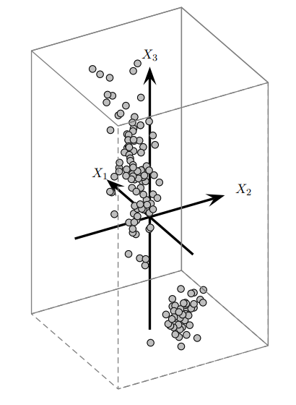
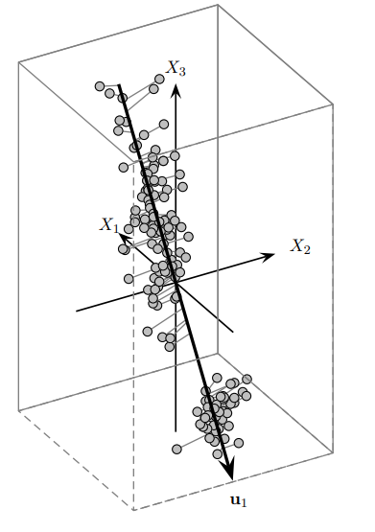
Iris Data: Optimal One-Dimensional basis
The direction that maximizes the variance is also the one that minimizes the squared error.
Iris Data: Optimal 1D Basis
Iris Data

Slide 15
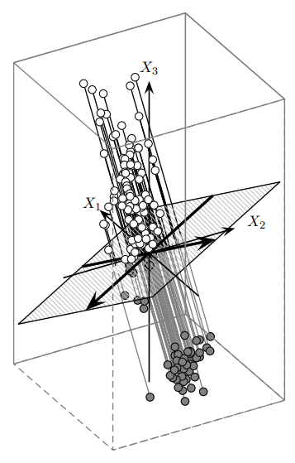
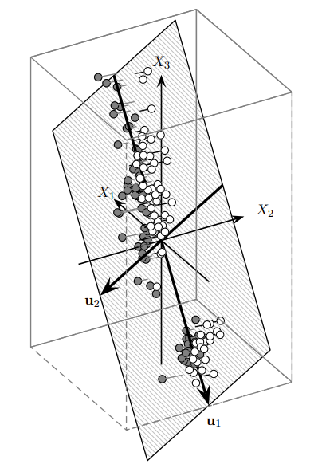
Iris Data: Optimal One-Dimensional basis
The direction that maximizes the variance is also the one that minimizes the squared error.
Iris Data: Non-Optimal 2D Basis
Iris Data
Iris Data: Optimal 2D Basis

Slide 16
Summary: PCA
Principal Component Analysis (PCA) is a technique that seeks a r-dimensional basis that best captures the variance in the dataset.
The direction with the largest projected variance is called the first principal component.
The orthogonal direction that captures the second largest projected variance is called the second principal component, and so on.
The direction that maximizes the variance is also the one that minimizes the mean squared errors.

Slide 17

Linear Transformations
Different $A$ matrices corresponds to different linear combinations:
$$A=\left(\begin{matrix}1 & −2 \\ 3 & 2\end{matrix}\right), x=\left(\begin{matrix}1 \\ 1\end{matrix}\right)$$
$$Ax=\left(\begin{matrix}1 & −2 \\ 3 & 2\end{matrix}\right)\left(\begin{matrix}1 \\ 1\end{matrix}\right)=\left(\begin{matrix}−1 \\ 5\end{matrix}\right)$$
Notes:
https://youtu.be/kYB8IZa5AuE?si=SCeGpjhuorESVbMM&t=79

Slide 18

Linear Transformations
Different $A$ matrices corresponds to different linear combinations:
$$A=\left(\begin{matrix}2 & −2 \\ 1 & 2\end{matrix}\right), x=\left(\begin{matrix}1 \\ 1\end{matrix}\right)$$
$$Ax=\left(\begin{matrix}2 & −2 \\ 1 & 2\end{matrix}\right)\left(\begin{matrix}1 \\ 1\end{matrix}\right)=\left(\begin{matrix}0 \\ 5\end{matrix}\right)$$

Slide 19

Linear Transformations
Different $A$ matrices corresponds to different linear combinations:
$$A=\left(\begin{matrix}2 & 1 \\ 2 & 2\end{matrix}\right), x=\left(\begin{matrix}1 \\ 1\end{matrix}\right)$$
$$Ax=\left(\begin{matrix}2 & 1 \\ 2 & 2\end{matrix}\right)\left(\begin{matrix}1 \\ 1\end{matrix}\right)=\left(\begin{matrix}3 \\ 4\end{matrix}\right)$$

Slide 20

Eigenvalues and eigenvectors
The special vectors that, when multiplied by A, it only change magnitude, are A’s eigenvectors and the change in magnitude is the eigenvalue:
$$A=\left(\begin{matrix}2 & 1 \\ 1 & 2\end{matrix}\right), x=\left(\begin{matrix}1 \\ 1\end{matrix}\right)$$
$$Ax=\left(\begin{matrix}2 & 1 \\ 1 & 2\end{matrix}\right)\left(\begin{matrix}1 \\ 1\end{matrix}\right)=\left(\begin{matrix}3 \\ 3\end{matrix}\right)=3⋅x$$

Slide 21

Eigenvalues and eigenvectors
The special vectors that, when multiplied by A, it only change magnitude, are A’s eigenvectors and the change in magnitude is the eigenvalue:
$$A=\left(\begin{matrix}2 & 1 \\ 1 & 2\end{matrix}\right), x=\left(\begin{matrix}1 \\ 1\end{matrix}\right)$$
$$Ax=\left(\begin{matrix}2 & 1 \\ 1 & 2\end{matrix}\right)\left(\begin{matrix}−1 \\ 1\end{matrix}\right)=\left(\begin{matrix}−1 \\ 1\end{matrix}\right)=1⋅x$$

Slide 22
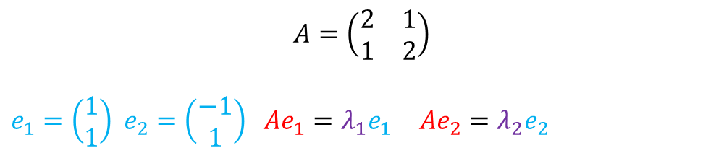
Eigenvalues and eigenvectors
The special vectors that, when multiplied by A, it only change magnitude, are A’s eigenvectors and the change in magnitude is the eigenvalue:
$$A=\left(\begin{matrix}2 & 1 \\ 1 & 2\end{matrix}\right)$$
$e_{1}=\left(\begin{matrix}1 \\ 1\end{matrix}\right)$ $e_{2}=\left(\begin{matrix}−1 \\ 1\end{matrix}\right)$ $Ae_{1}=λ_{1}e_{1}$ $Ae_{2}=λ_{2}e_{2}$

Slide 23
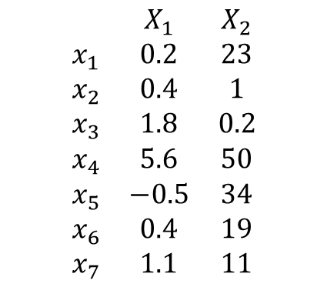
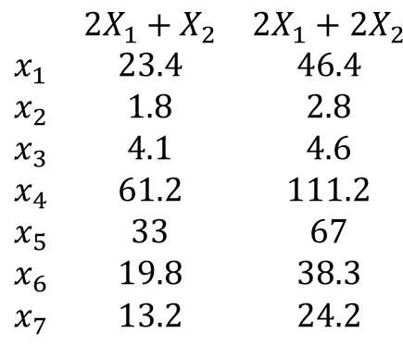
Eigenvalues and eigenvectors
Consider the following data matrix and linear transformation of each data instance.
$A=\left(\begin{matrix}2 & 1 \\ 1 & 2\end{matrix}\right)$ $x_{1}=\left(\begin{matrix}0.2 \\ 23\end{matrix}\right)$ $Ax_{1}=\left(\begin{matrix}2 & 1 \\ 1 & 2\end{matrix}\right)\left(\begin{matrix}0.2 \\ 23\end{matrix}\right)=\left(\begin{matrix}23.4 \\ 46.4\end{matrix}\right)$
$$\begin{matrix} & X_{1} & X_{2} \\ x_{1} & 0.2 & 23 \\ x_{2} & 0.4 & 1 \\ x_{3} & 1.8 & 0.2 \\ x_{4} & 5.6 & 50 \\ x_{5} & −0.5 & 34 \\ x_{6} & 0.4 & 19 \\ x_{7} & 1.1 & 11\end{matrix}$$
$$\begin{matrix} & 2X_{1}+X_{2} & {2X}_{1}+2X_{2} \\ x_{1} & 23.4 & 46.4 \\ x_{2} & 1.8 & 2.8 \\ x_{3} & 4.1 & 4.6 \\ x_{4} & 61.2 & 111.2 \\ x_{5} & 33 & 67 \\ x_{6} & 19.8 & 38.3 \\ x_{7} & 13.2 & 24.2\end{matrix}$$

Slide 24
PCA, Eigenvector and Eigenvalues
Let’s put them together
The first principal component direction of the data is that along which the observations vary the most. These directions are precisely what we call the eigenvectors of the data's covariance matrix.
Once we identify these directions (eigenvectors), we need to know how significant or important each direction is. This is where we use eigenvalues to rank each eigenvector. Eigenvalue associated with each eigenvector tells us how much variance is associated along each eigenvector.
Larger the eigenvalue, larger variance is captured by the eigenvector.
In PCA, we rank these eigenvectors (and their corresponding eigenvalues) from most important to least important. By selecting the top few eigenvectors, we can project our original dataset onto simpler, smaller, shadow that still captures the structure of the dataset.

Slide 25
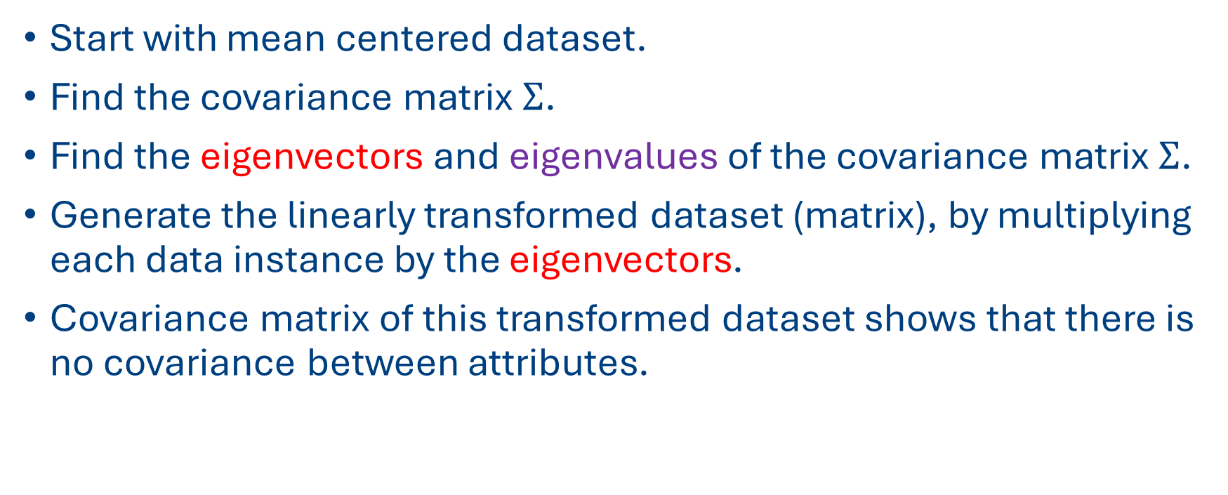

Transformations using Eigenvectors of $Σ$
Start with mean centered dataset.
Find the covariance matrix $Σ$.
Find the eigenvectors and eigenvalues of the covariance matrix $Σ$.
Generate the linearly transformed dataset (matrix), by multiplying each data instance by the eigenvectors.
Covariance matrix of this transformed dataset shows that there is no covariance between attributes.

Slide 26
PCA Algorithms
Let’s go through an example.

Slide 27
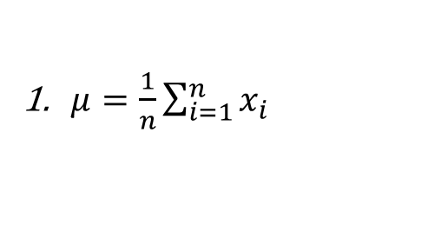
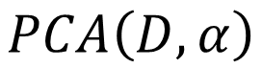
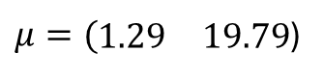
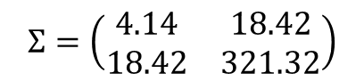
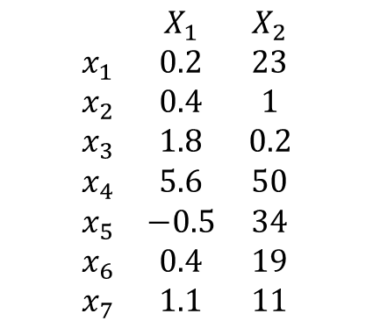
PCA Algorithm
$$\begin{matrix} & X_{1} & X_{2} \\ x_{1} & 0.2 & 23 \\ x_{2} & 0.4 & 1 \\ x_{3} & 1.8 & 0.2 \\ x_{4} & 5.6 & 50 \\ x_{5} & −0.5 & 34 \\ x_{6} & 0.4 & 19 \\ x_{7} & 1.1 & 11\end{matrix}$$
$$PCA\left(D, α\right)$$
$μ=\frac{1}{n}\sum_{i=1}^{n}{x_{i}}$
$$Σ=\left(\begin{matrix}4.14 & 18.42 \\ 18.42 & 321.32\end{matrix}\right)$$
$μ=(\begin{matrix}1.29 & 19.79\end{matrix}$)

Slide 28
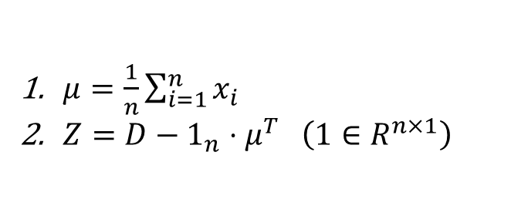
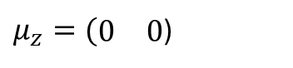
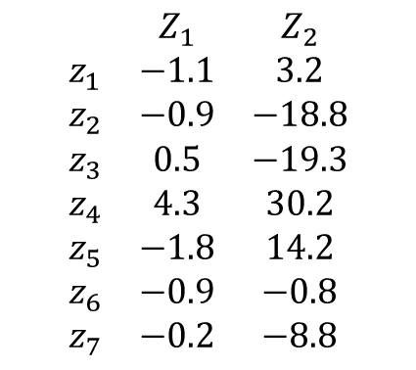
PCA Algorithm
$$\begin{matrix} & Z_{1} & Z_{2} \\ z_{1} & −1.1 & 3.2 \\ z_{2} & −0.9 & −18.8 \\ z_{3} & 0.5 & −19.3 \\ z_{4} & 4.3 & 30.2 \\ z_{5} & −1.8 & 14.2 \\ z_{6} & −0.9 & −0.8 \\ z_{7} & −0.2 & −8.8\end{matrix}$$
$$PCA\left(D, α\right)$$
$μ=\frac{1}{n}\sum_{i=1}^{n}{x_{i}}$
$Z=D−1_{n}⋅μ^{T} \left(1∈R^{n×1}\right)$
$μ_{z}=(\begin{matrix}0 & 0\end{matrix}$)

Slide 29
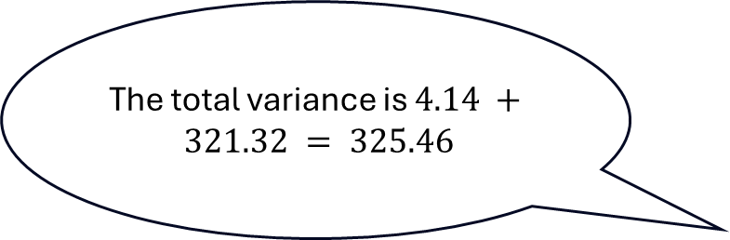
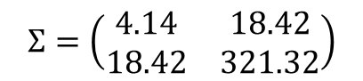
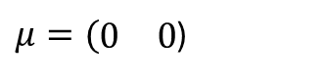
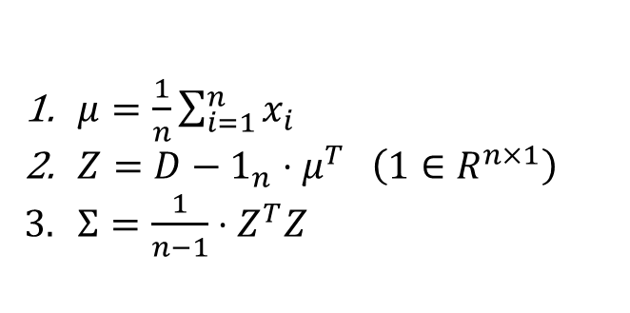
PCA Algorithm
$$\begin{matrix} & Z_{1} & Z_{2} \\ z_{1} & −1.1 & 3.2 \\ z_{2} & −0.9 & −18.8 \\ z_{3} & 0.5 & −19.3 \\ z_{4} & 4.3 & 30.2 \\ z_{5} & −1.8 & 14.2 \\ z_{6} & −0.9 & −0.8 \\ z_{7} & −0.2 & −8.8\end{matrix}$$
$$PCA\left(D, α\right)$$
$μ=\frac{1}{n}\sum_{i=1}^{n}{x_{i}}$
$Z=D−1_{n}⋅μ^{T} \left(1∈R^{n×1}\right)$
$Σ=\frac{1}{n−1}⋅Z^{T}Z$
The total variance is $4.14 + 321.32 = 325.46$
$μ=(\begin{matrix}0 & 0\end{matrix}$)
$$Σ=\left(\begin{matrix}4.14 & 18.42 \\ 18.42 & 321.32\end{matrix}\right)$$

Slide 30
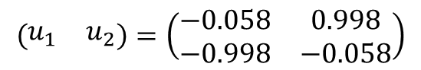
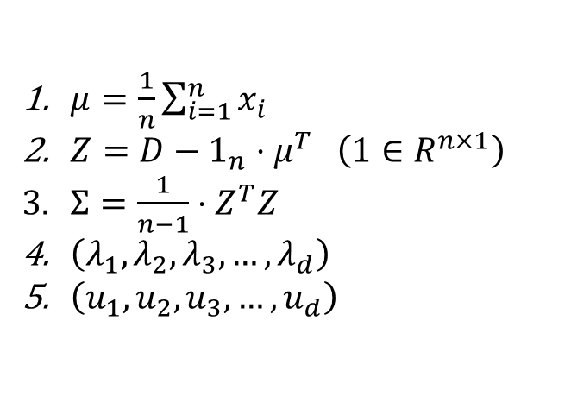
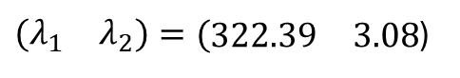
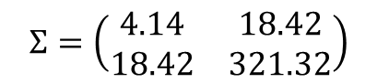
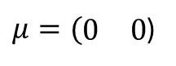
PCA Algorithm
$$\begin{matrix} & Z_{1} & Z_{2} \\ z_{1} & −1.1 & 3.2 \\ z_{2} & −0.9 & −18.8 \\ z_{3} & 0.5 & −19.3 \\ z_{4} & 4.3 & 30.2 \\ z_{5} & −1.8 & 14.2 \\ z_{6} & −0.9 & −0.8 \\ z_{7} & −0.2 & −8.8\end{matrix}$$
$$PCA\left(D, α\right)$$
$μ=\frac{1}{n}\sum_{i=1}^{n}{x_{i}}$
$Z=D−1_{n}⋅μ^{T} \left(1∈R^{n×1}\right)$
$Σ=\frac{1}{n−1}⋅Z^{T}Z$
$\left(λ_{1},λ_{2},λ_{3}, …,λ_{d}\right)$
$\left(u_{1},u_{2},u_{3}, …,u_{d}\right)$
$μ=(\begin{matrix}0 & 0\end{matrix}$)
$$Σ=\left(\begin{matrix}4.14 & 18.42 \\ 18.42 & 321.32\end{matrix}\right)$$
$\left(\begin{matrix}λ_{1} & λ_{2}\end{matrix}\right)=(\begin{matrix}322.39 & 3.08\end{matrix}$)
$$\left(\begin{matrix}u_{1} & u_{2}\end{matrix}\right)=\left(\begin{matrix}−0.058 & 0.998 \\ −0.998 & −0.058\end{matrix}\right)$$

Slide 31
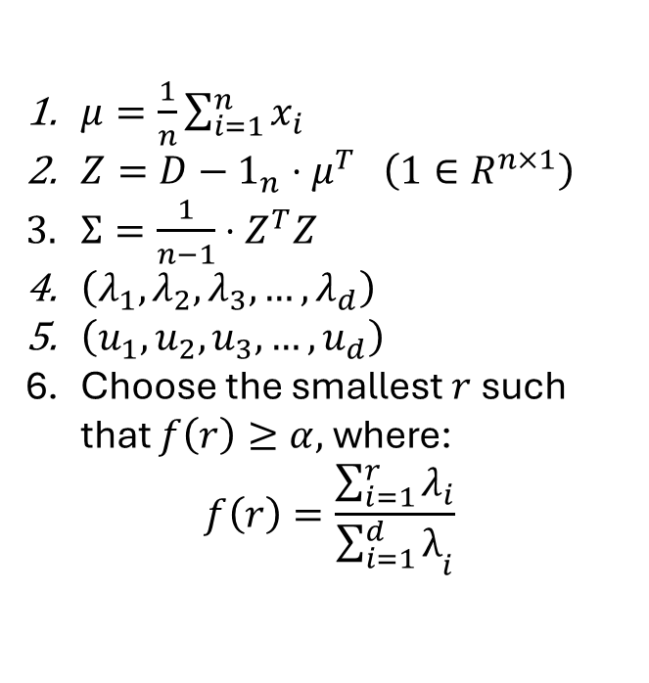
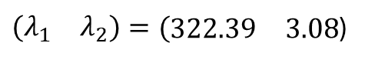

PCA Algorithm
$$\begin{matrix} & Z_{1} & Z_{2} \\ z_{1} & −1.1 & 3.2 \\ z_{2} & −0.9 & −18.8 \\ z_{3} & 0.5 & −19.3 \\ z_{4} & 4.3 & 30.2 \\ z_{5} & −1.8 & 14.2 \\ z_{6} & −0.9 & −0.8 \\ z_{7} & −0.2 & −8.8\end{matrix}$$
$$PCA\left(D, α\right)$$
$μ=\frac{1}{n}\sum_{i=1}^{n}{x_{i}}$
$Z=D−1_{n}⋅μ^{T} \left(1∈R^{n×1}\right)$
$Σ=\frac{1}{n−1}⋅Z^{T}Z$
$\left(λ_{1},λ_{2},λ_{3}, …,λ_{d}\right)$
$\left(u_{1},u_{2},u_{3}, …,u_{d}\right)$
Choose the smallest $r$ such that $f\left(r\right)≥α,$ where:
$$f\left(r\right)=\frac{\sum_{i=1}^{r}{λ_{i}}}{{\sum_{i=1}^{d}{λ}}_{i}}$$
This is the fraction of total variance that is preserved in the first $r$ principal components!
$μ=(\begin{matrix}0 & 0\end{matrix}$)
$$Σ=\left(\begin{matrix}4.14 & 18.42 \\ 18.42 & 321.32\end{matrix}\right)$$
$\left(\begin{matrix}λ_{1} & λ_{2}\end{matrix}\right)=(\begin{matrix}322.39 & 3.08\end{matrix}$)
$$\left(\begin{matrix}u_{1} & u_{2}\end{matrix}\right)=\left(\begin{matrix}−0.058 & 0.998 \\ −0.998 & −0.058\end{matrix}\right)$$

Slide 32
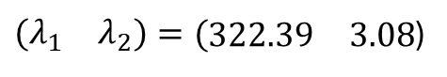
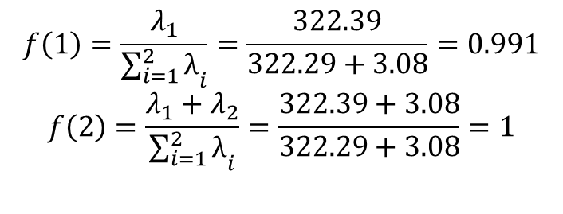
PCA Algorithm
$$\begin{matrix} & Z_{1} & Z_{2} \\ z_{1} & −1.1 & 3.2 \\ z_{2} & −0.9 & −18.8 \\ z_{3} & 0.5 & −19.3 \\ z_{4} & 4.3 & 30.2 \\ z_{5} & −1.8 & 14.2 \\ z_{6} & −0.9 & −0.8 \\ z_{7} & −0.2 & −8.8\end{matrix}$$
$$PCA\left(D, α\right)$$
$μ=\frac{1}{n}\sum_{i=1}^{n}{x_{i}}$
$Z=D−1_{n}⋅μ^{T} \left(1∈R^{n×1}\right)$
$Σ=\frac{1}{n−1}⋅Z^{T}Z$
$\left(λ_{1},λ_{2},λ_{3}, …,λ_{d}\right)$
$\left(u_{1},u_{2},u_{3}, …,u_{d}\right)$
Choose the smallest $r$ such that $f\left(r\right)≥α,$ where:
$$f\left(r\right)=\frac{\sum_{i=1}^{r}{λ_{i}}}{{\sum_{i=1}^{d}{λ}}_{i}}$$
$μ=(\begin{matrix}0 & 0\end{matrix}$)
$$Σ=\left(\begin{matrix}4.14 & 18.42 \\ 18.42 & 321.32\end{matrix}\right)$$
$\left(\begin{matrix}λ_{1} & λ_{2}\end{matrix}\right)=(\begin{matrix}322.39 & 3.08\end{matrix}$)
$$\left(\begin{matrix}u_{1} & u_{2}\end{matrix}\right)=\left(\begin{matrix}−0.058 & 0.998 \\ −0.998 & −0.058\end{matrix}\right)$$
$$f\left(1\right)=\frac{λ_{1}}{{\sum_{i=1}^{2}{λ}}_{i}}=\frac{322.39}{322.29+3.08}=0.991$$
$$f\left(2\right)=\frac{λ_{1}+λ_{2}}{{\sum_{i=1}^{2}{λ}}_{i}}=\frac{322.39+3.08}{322.29+3.08}=1$$

Slide 33
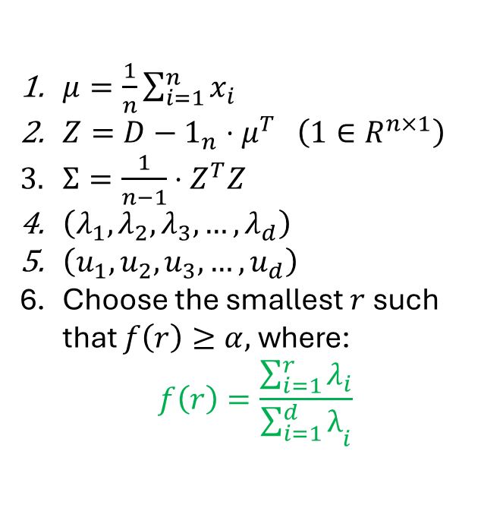
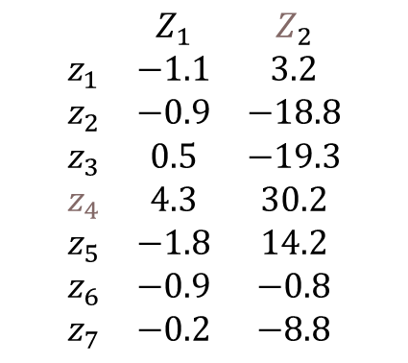
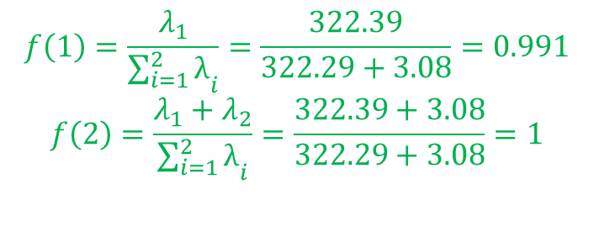
PCA Algorithm
$$\begin{matrix} & Z_{1} & Z_{2} \\ z_{1} & −1.1 & 3.2 \\ z_{2} & −0.9 & −18.8 \\ z_{3} & 0.5 & −19.3 \\ z_{4} & 4.3 & 30.2 \\ z_{5} & −1.8 & 14.2 \\ z_{6} & −0.9 & −0.8 \\ z_{7} & −0.2 & −8.8\end{matrix}$$
$$PCA\left(D, α\right)$$
$μ=\frac{1}{n}\sum_{i=1}^{n}{x_{i}}$
$Z=D−1_{n}⋅μ^{T} \left(1∈R^{n×1}\right)$
$Σ=\frac{1}{n−1}⋅Z^{T}Z$
$\left(λ_{1},λ_{2},λ_{3}, …,λ_{d}\right)$
$\left(u_{1},u_{2},u_{3}, …,u_{d}\right)$
Choose the smallest $r$ such that $f\left(r\right)≥α,$ where:
$$f\left(r\right)=\frac{\sum_{i=1}^{r}{λ_{i}}}{{\sum_{i=1}^{d}{λ}}_{i}}$$
This means over 99% of the variance is captured in the direction of the first principal component
$μ=(\begin{matrix}0 & 0\end{matrix}$)
$$Σ=\left(\begin{matrix}4.14 & 18.42 \\ 18.42 & 321.32\end{matrix}\right)$$
$\left(\begin{matrix}λ_{1} & λ_{2}\end{matrix}\right)=(\begin{matrix}322.39 & 3.08\end{matrix}$)
$$\left(\begin{matrix}u_{1} & u_{2}\end{matrix}\right)=\left(\begin{matrix}−0.058 & 0.998 \\ −0.998 & −0.058\end{matrix}\right)$$
$$f\left(1\right)=\frac{λ_{1}}{{\sum_{i=1}^{2}{λ}}_{i}}=\frac{322.39}{322.29+3.08}=0.991$$
$$f\left(2\right)=\frac{λ_{1}+λ_{2}}{{\sum_{i=1}^{2}{λ}}_{i}}=\frac{322.39+3.08}{322.29+3.08}=1$$

Slide 34
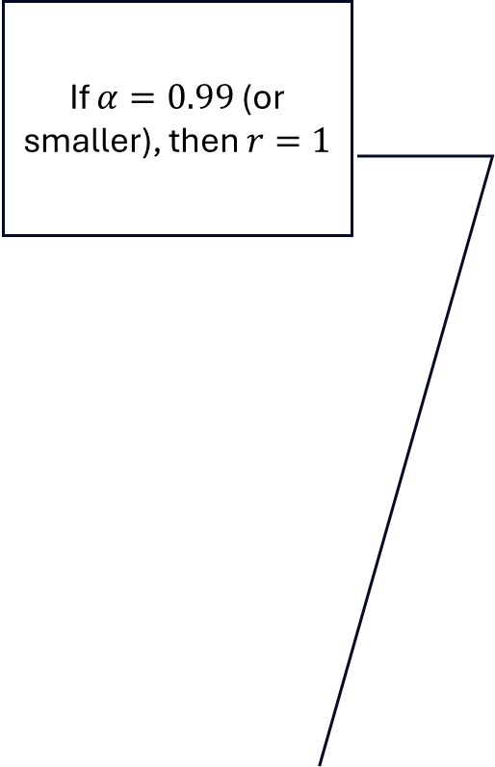
PCA Algorithm
If $α=0.99$ (or smaller), then $r=1$
$$\begin{matrix} & Z_{1} & Z_{2} \\ z_{1} & −1.1 & 3.2 \\ z_{2} & −0.9 & −18.8 \\ z_{3} & 0.5 & −19.3 \\ z_{4} & 4.3 & 30.2 \\ z_{5} & −1.8 & 14.2 \\ z_{6} & −0.9 & −0.8 \\ z_{7} & −0.2 & −8.8\end{matrix}$$
$$PCA\left(D, α\right)$$
$μ=\frac{1}{n}\sum_{i=1}^{n}{x_{i}}$
$Z=D−1_{n}⋅μ^{T} \left(1∈R^{n×1}\right)$
$Σ=\frac{1}{n−1}⋅Z^{T}Z$
$\left(λ_{1},λ_{2},λ_{3}, …,λ_{d}\right)$
$\left(u_{1},u_{2},u_{3}, …,u_{d}\right)$
Choose the smallest $r$ such that $f\left(r\right)≥α,$ where:
$$f\left(r\right)=\frac{\sum_{i=1}^{r}{λ_{i}}}{{\sum_{i=1}^{d}{λ}}_{i}}$$
This means over 99% of the variance is captured in the direction of the first principal component
$μ=(\begin{matrix}0 & 0\end{matrix}$)
$$Σ=\left(\begin{matrix}4.14 & 18.42 \\ 18.42 & 321.32\end{matrix}\right)$$
$\left(\begin{matrix}λ_{1} & λ_{2}\end{matrix}\right)=(\begin{matrix}322.39 & 3.08\end{matrix}$)
$$\left(\begin{matrix}u_{1} & u_{2}\end{matrix}\right)=\left(\begin{matrix}−0.058 & 0.998 \\ −0.998 & −0.058\end{matrix}\right)$$
$$f\left(1\right)=\frac{λ_{1}}{{\sum_{i=1}^{2}{λ}}_{i}}=\frac{322.39}{322.29+3.08}=0.991$$
$$f\left(2\right)=\frac{λ_{1}+λ_{2}}{{\sum_{i=1}^{2}{λ}}_{i}}=\frac{322.39+3.08}{322.29+3.08}=1$$

Slide 35
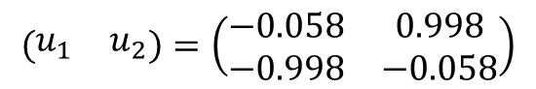
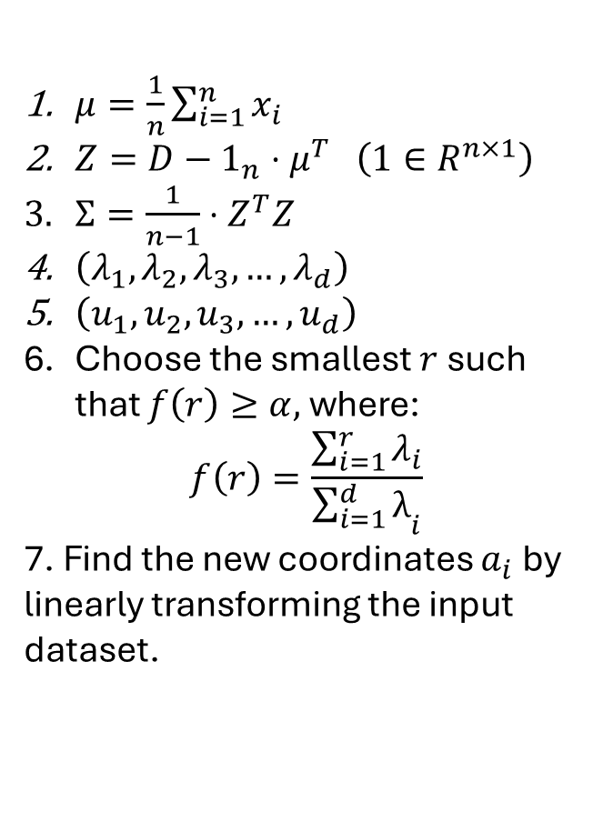
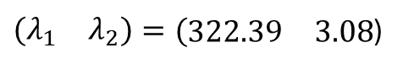
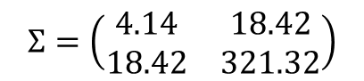
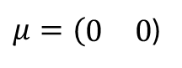
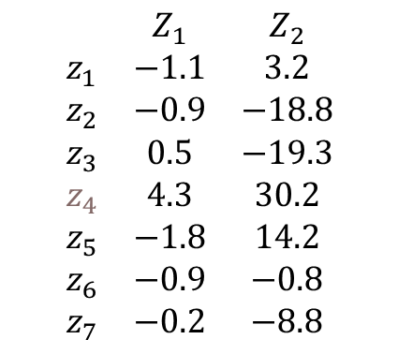
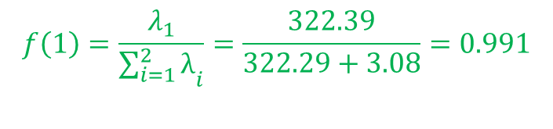
PCA Algorithm
$$\begin{matrix} & Z_{1} & Z_{2} \\ z_{1} & −1.1 & 3.2 \\ z_{2} & −0.9 & −18.8 \\ z_{3} & 0.5 & −19.3 \\ z_{4} & 4.3 & 30.2 \\ z_{5} & −1.8 & 14.2 \\ z_{6} & −0.9 & −0.8 \\ z_{7} & −0.2 & −8.8\end{matrix}$$
$$PCA\left(D, α\right)$$
$μ=\frac{1}{n}\sum_{i=1}^{n}{x_{i}}$
$Z=D−1_{n}⋅μ^{T} \left(1∈R^{n×1}\right)$
$Σ=\frac{1}{n−1}⋅Z^{T}Z$
$\left(λ_{1},λ_{2},λ_{3}, …,λ_{d}\right)$
$\left(u_{1},u_{2},u_{3}, …,u_{d}\right)$
Choose the smallest $r$ such that $f\left(r\right)≥α,$ where:
$$f\left(r\right)=\frac{\sum_{i=1}^{r}{λ_{i}}}{{\sum_{i=1}^{d}{λ}}_{i}}$$
7. Find the new coordinates $a_{i}$ by linearly transforming the input dataset.
$μ=(\begin{matrix}0 & 0\end{matrix}$)
$$Σ=\left(\begin{matrix}4.14 & 18.42 \\ 18.42 & 321.32\end{matrix}\right)$$
$$f\left(1\right)=\frac{λ_{1}}{{\sum_{i=1}^{2}{λ}}_{i}}=\frac{322.39}{322.29+3.08}=0.991$$
$\left(\begin{matrix}λ_{1} & λ_{2}\end{matrix}\right)=(\begin{matrix}322.39 & 3.08\end{matrix}$)
$$\left(\begin{matrix}u_{1} & u_{2}\end{matrix}\right)=\left(\begin{matrix}−0.058 & 0.998 \\ −0.998 & −0.058\end{matrix}\right)$$

Slide 36
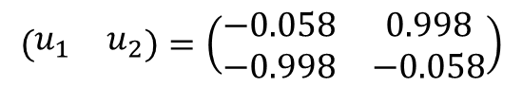
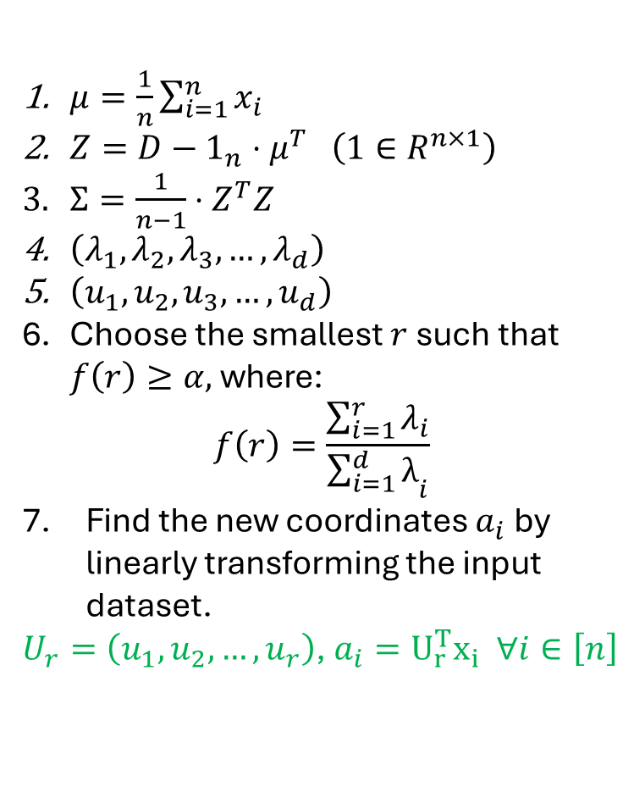
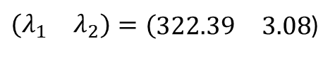






PCA Algorithm
$$\begin{matrix} & Z_{1} & Z_{2} \\ z_{1} & −1.1 & 3.2 \\ z_{2} & −0.9 & −18.8 \\ z_{3} & 0.5 & −19.3 \\ z_{4} & 4.3 & 30.2 \\ z_{5} & −1.8 & 14.2 \\ z_{6} & −0.9 & −0.8 \\ z_{7} & −0.2 & −8.8\end{matrix}$$
$$PCA\left(D, α\right)$$
$μ=\frac{1}{n}\sum_{i=1}^{n}{x_{i}}$
$Z=D−1_{n}⋅μ^{T} \left(1∈R^{n×1}\right)$
$Σ=\frac{1}{n−1}⋅Z^{T}Z$
$\left(λ_{1},λ_{2},λ_{3}, …,λ_{d}\right)$
$\left(u_{1},u_{2},u_{3}, …,u_{d}\right)$
Choose the smallest $r$ such that $f\left(r\right)≥α,$ where:
$$f\left(r\right)=\frac{\sum_{i=1}^{r}{λ_{i}}}{{\sum_{i=1}^{d}{λ}}_{i}}$$
Find the new coordinates $a_{i}$ by linearly transforming the input dataset.
$U_{r}=\left(u_{1},u_{2},…, u_{r}\right)$, $a_{i}=U_{r}^{T}x_{i} ∀i∈\left[n\right]$
$μ=(\begin{matrix}0 & 0\end{matrix}$)
$$Σ=\left(\begin{matrix}4.14 & 18.42 \\ 18.42 & 321.32\end{matrix}\right)$$
$$f\left(1\right)=\frac{λ_{1}}{{\sum_{i=1}^{2}{λ}}_{i}}=\frac{322.39}{322.29+3.08}=0.991$$
$\left(\begin{matrix}λ_{1} & λ_{2}\end{matrix}\right)=(\begin{matrix}322.39 & 3.08\end{matrix}$)
$$\left(\begin{matrix}u_{1} & u_{2}\end{matrix}\right)=\left(\begin{matrix}−0.058 & 0.998 \\ −0.998 & −0.058\end{matrix}\right)$$
$$U_{1}=\left(u_{1}\right)=\left(\begin{matrix}−0.058 \\ −0.998\end{matrix}\right)$$
$$U_{1}^{T}=\left(u_{1}^{T}\right)=\left(\begin{matrix}−0.058 & −0.998\end{matrix}\right)$$
$$D_{transformed= }\begin{matrix} & {−0.058X}_{1}−0.998X_{2} & \\ a_{1} & U_{1}^{T}x_{1} & \\ a_{2} & U_{1}^{T}x_{2} & \\ a_{3} & U_{1}^{T}x_{3} & \\ a_{4} & U_{1}^{T}x_{4} & \\ a_{5} & U_{1}^{T}x_{5} & \\ a_{6} & U_{1}^{T}x_{6} & \\ a_{7} & U_{1}^{T}x_{7} & \end{matrix}$$

Slide 37




PCA Algorithm
$$\begin{matrix} & Z_{1} & Z_{2} \\ z_{1} & −1.1 & 3.2 \\ z_{2} & −0.9 & −18.8 \\ z_{3} & 0.5 & −19.3 \\ z_{4} & 4.3 & 30.2 \\ z_{5} & −1.8 & 14.2 \\ z_{6} & −0.9 & −0.8 \\ z_{7} & −0.2 & −8.8\end{matrix}$$
$$PCA\left(D, α\right)$$
$μ=\frac{1}{n}\sum_{i=1}^{n}{x_{i}}$
$Z=D−1_{n}⋅μ^{T} \left(1∈R^{n×1}\right)$
$Σ=\frac{1}{n−1}⋅Z^{T}Z$
$\left(λ_{1},λ_{2},λ_{3}, …,λ_{d}\right)$
$\left(u_{1},u_{2},u_{3}, …,u_{d}\right)$
Choose the smallest $r$ such that $f\left(r\right)≥α,$ where:
$$f\left(r\right)=\frac{\sum_{i=1}^{r}{λ_{i}}}{{\sum_{i=1}^{d}{λ}}_{i}}$$
Find the new coordinates $a_{i}$ by linearly transforming the input dataset.
$U_{r}=\left(u_{1},u_{2},…, u_{r}\right)$, $a_{i}=U_{r}^{T}x_{i} ∀i∈\left[n\right]$
$μ=(\begin{matrix}0 & 0\end{matrix}$)
$$Σ=\left(\begin{matrix}4.14 & 18.42 \\ 18.42 & 321.32\end{matrix}\right)$$
$$f\left(1\right)=\frac{λ_{1}}{{\sum_{i=1}^{2}{λ}}_{i}}=\frac{322.39}{322.29+3.08}=0.991$$
$\left(\begin{matrix}λ_{1} & λ_{2}\end{matrix}\right)=(\begin{matrix}322.39 & 3.08\end{matrix}$)
$$\left(\begin{matrix}u_{1} & u_{2}\end{matrix}\right)=\left(\begin{matrix}−0.058 & 0.998 \\ −0.998 & −0.058\end{matrix}\right)$$
$$U_{1}=\left(u_{1}\right)=\left(\begin{matrix}−0.058 \\ −0.998\end{matrix}\right)$$
$$U_{1}^{T}=\left(u_{1}^{T}\right)=\left(\begin{matrix}−0.058 & −0.998\end{matrix}\right)$$
$$D_{transformed= }\begin{matrix} & {−0.058X}_{1}−0.998X_{2} & \\ a_{1} & −0.058\left(−1.1\right)−0.998\left(3.2\right) & \\ a_{2} & −0.058\left(−0.9\right)−0.998\left(−18.8\right) & \\ a_{3} & −0.058\left(0.5\right)−0.998\left(−19.3\right) & \\ a_{4} & −0.058\left(4.3\right)−0.998\left(30.2\right) & \\ a_{5} & −0.058\left(−1.8\right)−0.998\left(14.2\right) & \\ a_{6} & −0.058\left(−0.9\right)−0.998\left(−0.8\right) & \\ a_{7} & −0.058\left(−0.2\right)−0.998\left(−8.8\right) & \end{matrix}$$

Slide 38

PCA Algorithm
$$\begin{matrix} & Z_{1} & Z_{2} \\ z_{1} & −1.1 & 3.2 \\ z_{2} & −0.9 & −18.8 \\ z_{3} & 0.5 & −19.3 \\ z_{4} & 4.3 & 30.2 \\ z_{5} & −1.8 & 14.2 \\ z_{6} & −0.9 & −0.8 \\ z_{7} & −0.2 & −8.8\end{matrix}$$
$$a_{2}=U_{1}^{T}x_{2}=\left(\begin{matrix}−0.058 & −0.998\end{matrix}\right)\left(\begin{matrix}−0.9 \\ −18.8\end{matrix}\right)$$
$$PCA\left(D, α\right)$$
$μ=\frac{1}{n}\sum_{i=1}^{n}{x_{i}}$
$Z=D−1_{n}⋅μ^{T} \left(1∈R^{n×1}\right)$
$Σ=\frac{1}{n−1}⋅Z^{T}Z$
$\left(λ_{1},λ_{2},λ_{3}, …,λ_{d}\right)$
$\left(u_{1},u_{2},u_{3}, …,u_{d}\right)$
Choose the smallest $r$ such that $f\left(r\right)≥α,$ where:
$$f\left(r\right)=\frac{\sum_{i=1}^{r}{λ_{i}}}{{\sum_{i=1}^{d}{λ}}_{i}}$$
Find the new coordinates $a_{i}$ by linearly transforming the input dataset.
$U_{r}=\left(u_{1},u_{2},…, u_{r}\right)$, $a_{i}=U_{r}^{T}x_{i} ∀i∈\left[n\right]$
$μ=(\begin{matrix}0 & 0\end{matrix}$)
$$Σ=\left(\begin{matrix}4.14 & 18.42 \\ 18.42 & 321.32\end{matrix}\right)$$
$$f\left(1\right)=\frac{λ_{1}}{{\sum_{i=1}^{2}{λ}}_{i}}=\frac{322.39}{322.29+3.08}=0.991$$
$\left(\begin{matrix}λ_{1} & λ_{2}\end{matrix}\right)=(\begin{matrix}322.39 & 3.08\end{matrix}$)
$$\left(\begin{matrix}u_{1} & u_{2}\end{matrix}\right)=\left(\begin{matrix}−0.058 & 0.998 \\ −0.998 & −0.058\end{matrix}\right)$$
$$U_{1}=\left(u_{1}\right)=\left(\begin{matrix}−0.058 \\ −0.998\end{matrix}\right)$$
$$U_{1}^{T}=\left(u_{1}^{T}\right)=\left(\begin{matrix}−0.058 & −0.998\end{matrix}\right)$$
$$D_{transformed= }\begin{matrix} & {−0.058X}_{1}−0.998X_{2} & \\ a_{1} & −0.058\left(−1.1\right)−0.998\left(3.2\right) & \\ a_{2} & −0.058\left(−0.9\right)−0.998\left(−18.8\right) & \\ a_{3} & −0.058\left(0.5\right)−0.998\left(−19.3\right) & \\ a_{4} & −0.058\left(4.3\right)−0.998\left(30.2\right) & \\ a_{5} & −0.058\left(−1.8\right)−0.998\left(14.2\right) & \\ a_{6} & −0.058\left(−0.9\right)−0.998\left(−0.8\right) & \\ a_{7} & −0.058\left(−0.2\right)−0.998\left(−8.8\right) & \end{matrix}$$

Slide 39



PCA Algorithm
$$\begin{matrix} & Z_{1} & Z_{2} \\ z_{1} & −1.1 & 3.2 \\ z_{2} & −0.9 & −18.8 \\ z_{3} & 0.5 & −19.3 \\ z_{4} & 4.3 & 30.2 \\ z_{5} & −1.8 & 14.2 \\ z_{6} & −0.9 & −0.8 \\ z_{7} & −0.2 & −8.8\end{matrix}$$
$$PCA\left(D, α\right)$$
$μ=\frac{1}{n}\sum_{i=1}^{n}{x_{i}}$
$Z=D−1_{n}⋅μ^{T} \left(1∈R^{n×1}\right)$
$Σ=\frac{1}{n−1}⋅Z^{T}Z$
$\left(λ_{1},λ_{2},λ_{3}, …,λ_{d}\right)$
$\left(u_{1},u_{2},u_{3}, …,u_{d}\right)$
Choose the smallest $r$ such that $f\left(r\right)≥α,$ where:
$$f\left(r\right)=\frac{\sum_{i=1}^{r}{λ_{i}}}{{\sum_{i=1}^{d}{λ}}_{i}}$$
Find the new coordinates $a_{i}$ by linearly transforming the input dataset.
$U_{r}=\left(u_{1},u_{2},…, u_{r}\right)$, $a_{i}=U_{r}^{T}x_{i} ∀i∈\left[n\right]$
$μ=(\begin{matrix}0 & 0\end{matrix}$)
$$Σ=\left(\begin{matrix}4.14 & 18.42 \\ 18.42 & 321.32\end{matrix}\right)$$
$$f\left(1\right)=\frac{λ_{1}}{{\sum_{i=1}^{2}{λ}}_{i}}=\frac{322.39}{322.29+3.08}=0.991$$
$\left(\begin{matrix}λ_{1} & λ_{2}\end{matrix}\right)=(\begin{matrix}322.39 & 3.08\end{matrix}$)
$$\left(\begin{matrix}u_{1} & u_{2}\end{matrix}\right)=\left(\begin{matrix}−0.058 & 0.998 \\ −0.998 & −0.058\end{matrix}\right)$$
$$U_{1}=\left(u_{1}\right)=\left(\begin{matrix}−0.058 \\ −0.998\end{matrix}\right)$$
$$U_{1}^{T}=\left(u_{1}^{T}\right)=\left(\begin{matrix}−0.058 & −0.998\end{matrix}\right)$$
$$D_{transformed= }\begin{matrix} & {−0.058X}_{1}−0.998X_{2} & \\ a_{1} & −22.97 & \\ a_{2} & −1.02 & \\ a_{3} & −0.60 & \\ a_{4} & −50.22 & \\ a_{5} & −33.90 & \\ a_{6} & −18.99 & \\ a_{7} & −11.04 & \end{matrix}$$

Slide 40
PCA Algorithm
$$\begin{matrix} & Z_{1} & Z_{2} \\ z_{1} & −1.1 & 3.2 \\ z_{2} & −0.9 & −18.8 \\ z_{3} & 0.5 & −19.3 \\ z_{4} & 4.3 & 30.2 \\ z_{5} & −1.8 & 14.2 \\ z_{6} & −0.9 & −0.8 \\ z_{7} & −0.2 & −8.8\end{matrix}$$
Now we have a 1-dimensional representation of original data that has almost all the variance of the 2-D dataset.
$$PCA\left(D, α\right)$$
$μ=\frac{1}{n}\sum_{i=1}^{n}{x_{i}}$
$Z=D−1_{n}⋅μ^{T} \left(1∈R^{n×1}\right)$
$Σ=\frac{1}{n−1}⋅Z^{T}Z$
$\left(λ_{1},λ_{2},λ_{3}, …,λ_{d}\right)$
$\left(u_{1},u_{2},u_{3}, …,u_{d}\right)$
Choose the smallest $r$ such that $f\left(r\right)≥α,$ where:
$$f\left(r\right)=\frac{\sum_{i=1}^{r}{λ_{i}}}{{\sum_{i=1}^{d}{λ}}_{i}}$$
Find the new coordinates $a_{i}$ by linearly transforming the input dataset.
$U_{r}=\left(u_{1},u_{2},…, u_{r}\right)$, $a_{i}=U_{r}^{T}x_{i} ∀i∈\left[n\right]$
$μ=(\begin{matrix}0 & 0\end{matrix}$)
$$Σ=\left(\begin{matrix}4.14 & 18.42 \\ 18.42 & 321.32\end{matrix}\right)$$
$$f\left(1\right)=\frac{λ_{1}}{{\sum_{i=1}^{2}{λ}}_{i}}=\frac{322.39}{322.29+3.08}=0.991$$
$\left(\begin{matrix}λ_{1} & λ_{2}\end{matrix}\right)=(\begin{matrix}322.39 & 3.08\end{matrix}$)
$$\left(\begin{matrix}u_{1} & u_{2}\end{matrix}\right)=\left(\begin{matrix}−0.058 & 0.998 \\ −0.998 & −0.058\end{matrix}\right)$$
$$U_{1}=\left(u_{1}\right)=\left(\begin{matrix}−0.058 \\ −0.998\end{matrix}\right)$$
$$U_{1}^{T}=\left(u_{1}^{T}\right)=\left(\begin{matrix}−0.058 & −0.998\end{matrix}\right)$$
$$D_{transformed= }\begin{matrix} & {−0.058X}_{1}−0.998X_{2} & \\ a_{1} & −22.97 & \\ a_{2} & −1.02 & \\ a_{3} & −0.60 & \\ a_{4} & −50.22 & \\ a_{5} & −33.90 & \\ a_{6} & −18.99 & \\ a_{7} & −11.04 & \end{matrix}$$

Slide 41



PCA Algorithm
$$\begin{matrix} & Z_{1} & Z_{2} \\ z_{1} & −1.1 & 3.2 \\ z_{2} & −0.9 & −18.8 \\ z_{3} & 0.5 & −19.3 \\ z_{4} & 4.3 & 30.2 \\ z_{5} & −1.8 & 14.2 \\ z_{6} & −0.9 & −0.8 \\ z_{7} & −0.2 & −8.8\end{matrix}$$
$$Σ=\left(\begin{matrix}4.14 & 18.42 \\ 18.42 & 321.32\end{matrix}\right)$$
$$PCA\left(D, α\right)$$
Original total variance was $325.46$
$μ=\frac{1}{n}\sum_{i=1}^{n}{x_{i}}$
$Z=D−1_{n}⋅μ^{T} \left(1∈R^{n×1}\right)$
$Σ=\frac{1}{n−1}⋅Z^{T}Z$
$\left(λ_{1},λ_{2},λ_{3}, …,λ_{d}\right)$
$\left(u_{1},u_{2},u_{3}, …,u_{d}\right)$
Choose the smallest $r$ such that $f\left(r\right)≥α,$ where:
$$f\left(r\right)=\frac{\sum_{i=1}^{r}{λ_{i}}}{{\sum_{i=1}^{d}{λ}}_{i}}$$
Find the new coordinates $a_{i}$ by linearly transforming the input dataset.
$U_{r}=\left(u_{1},u_{2},…, u_{r}\right)$, $a_{i}=U_{r}^{T}x_{i} ∀i∈\left[n\right]$
$μ=(\begin{matrix}0 & 0\end{matrix}$)
$$f\left(1\right)=\frac{λ_{1}}{{\sum_{i=1}^{2}{λ}}_{i}}=\frac{322.39}{322.29+3.08}=0.991$$
$\left(\begin{matrix}λ_{1} & λ_{2}\end{matrix}\right)=(\begin{matrix}322.39 & 3.08\end{matrix}$)
$$\left(\begin{matrix}u_{1} & u_{2}\end{matrix}\right)=\left(\begin{matrix}−0.058 & 0.998 \\ −0.998 & −0.058\end{matrix}\right)$$
$$U_{1}=\left(u_{1}\right)=\left(\begin{matrix}−0.058 \\ −0.998\end{matrix}\right)$$
$$U_{1}^{T}=\left(u_{1}^{T}\right)=\left(\begin{matrix}−0.058 & −0.998\end{matrix}\right)$$
$$D_{transformed= }\begin{matrix} & {−0.058X}_{1}−0.998X_{2} & \\ a_{1} & −22.97 & \\ a_{2} & −1.02 & \\ a_{3} & −0.60 & \\ a_{4} & −50.22 & \\ a_{5} & −33.90 & \\ a_{6} & −18.99 & \\ a_{7} & −11.04 & \end{matrix}$$
$$var\left(D_{transformed}\right)=322.16$$

